Slide 1
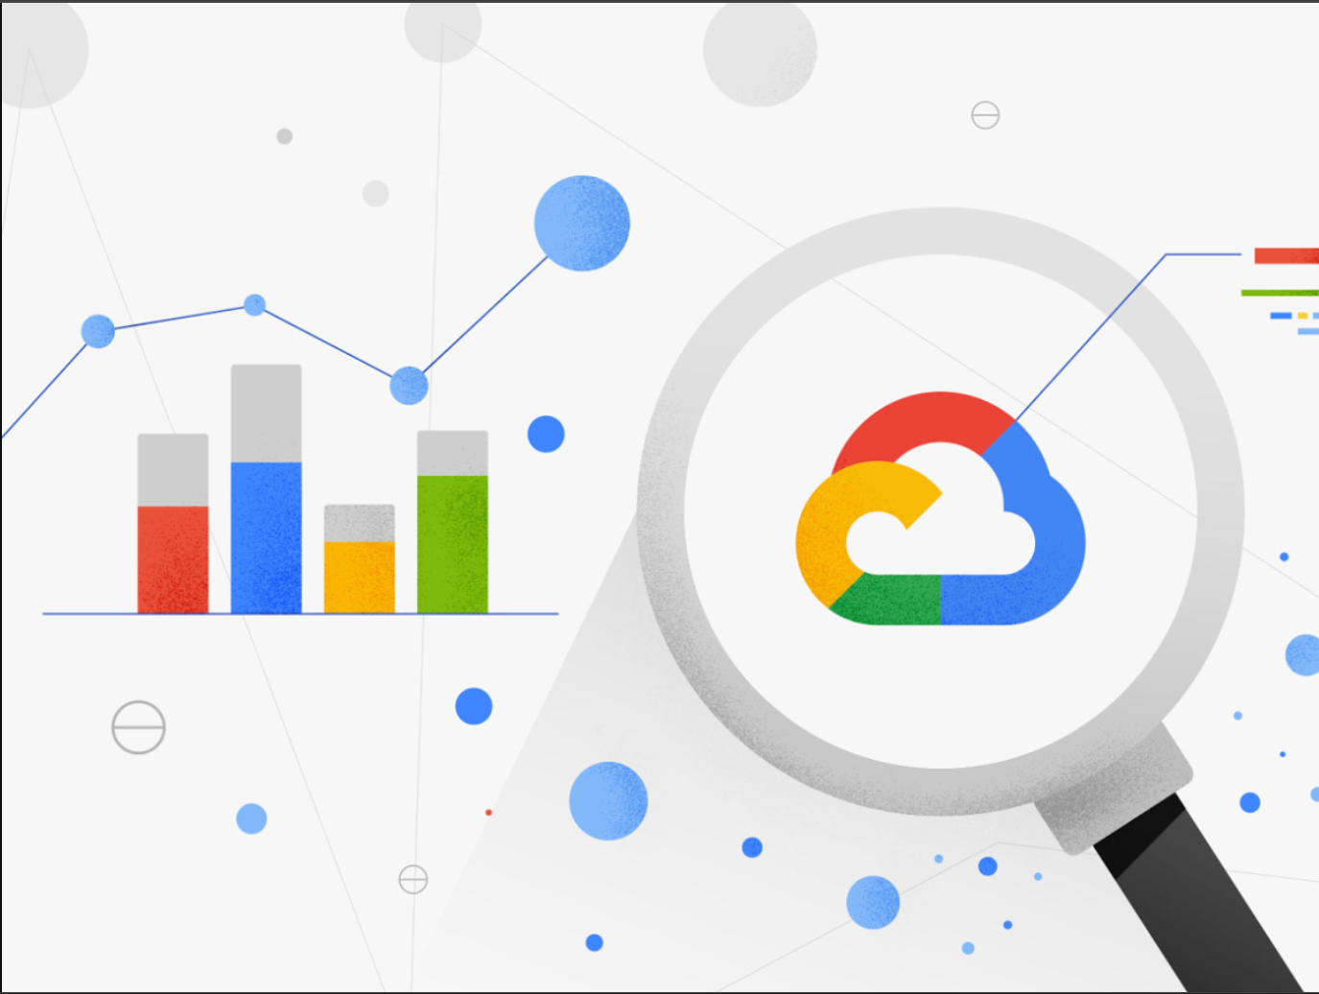
VISUALIZE DATA IN THE CLOUD
By,
Inchara S
4VV22IS041

Slide 2
What is Data Visualization?
Data visualization is the representation of data through use of common graphics, such as charts, plots, infographics and even animations. These visual displays of information communicate complex data relationships and data-driven insights in a way that is easy to understand.
Importance of Data Visualization
1. Simplifies Complex Data: Data visualization breaks down large data sets into easy-to-understand visuals. For instance, a Tableau heatmap uses red to highlight underperforming states, instantly identifying problem areas.
2. Enhances Data Interpretation: Visuals help uncover hidden patterns and trends. For example, a sales vs. profit chart might show that high sales don’t always mean high profits, guiding better strategic decisions.
3. Saves Time: Visualization highlights key insights at a glance, like instantly spotting loss-making states in a heatmap, instead of scanning through rows of data.
4. Improves Communication: Visuals like TreeMaps make data accessible to non-experts. For instance, a large rectangle for California clearly indicates high sales without needing complex interpretation.
5. Tells a Data Story: Data visualization presents a clear narrative. A visual of product profits and losses can lead to actionable recommendations, making insights more engaging and impactful.

Slide 3
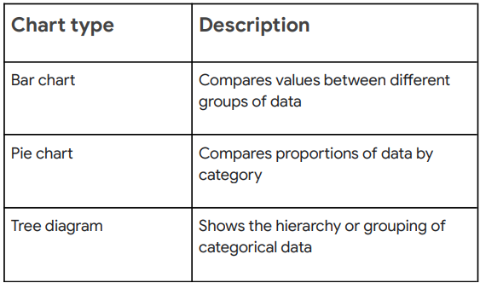
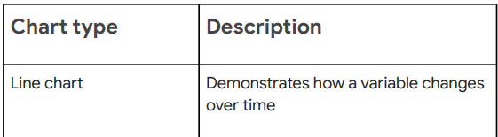
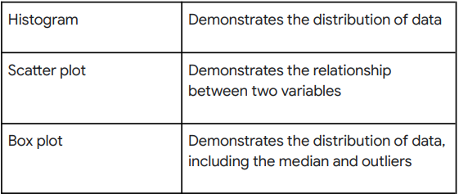

Visualization Decisions Based On Data Type
Numerical data
Categorical data
Since numerical data is focused on number values, graph types that draw attention to, and accurately portray the numbers will best represent the data. For example, a line chart typically draws attention to the variable on the Y-axis, which is a numerical value.
Since categorical data is descriptive, and groups values by a label or characteristic, visualizations that represent parts of a whole, or distinct categories, are more appropriate to illustrate the data’s meaning.

Slide 4
Dimensions And Measures In Data Models
Overview of Data Models
A data model is a way to organize data elements and define how they relate to each other.
Data models can be visually represented to show the structure and relationships within the data.
Every data source has a data model, even if it's not explicitly defined.
Dimensions
Dimensions are unique attributes that describe data.
In a table (such as one containing information about books), dimensions could include columns like title, genre, price, date published, and whether the book is in stock.
Each row in the table represents an item (e.g., a book) and contains values for each dimension.
Dimensions allow you to group and filter data to gain insights.
Measures
Measures are aggregations or calculations performed on dimensions, such as counts, sums, or averages.
Measures can also be used to calculate the sum or average of a particular dimension, like the average price of books

Slide 5

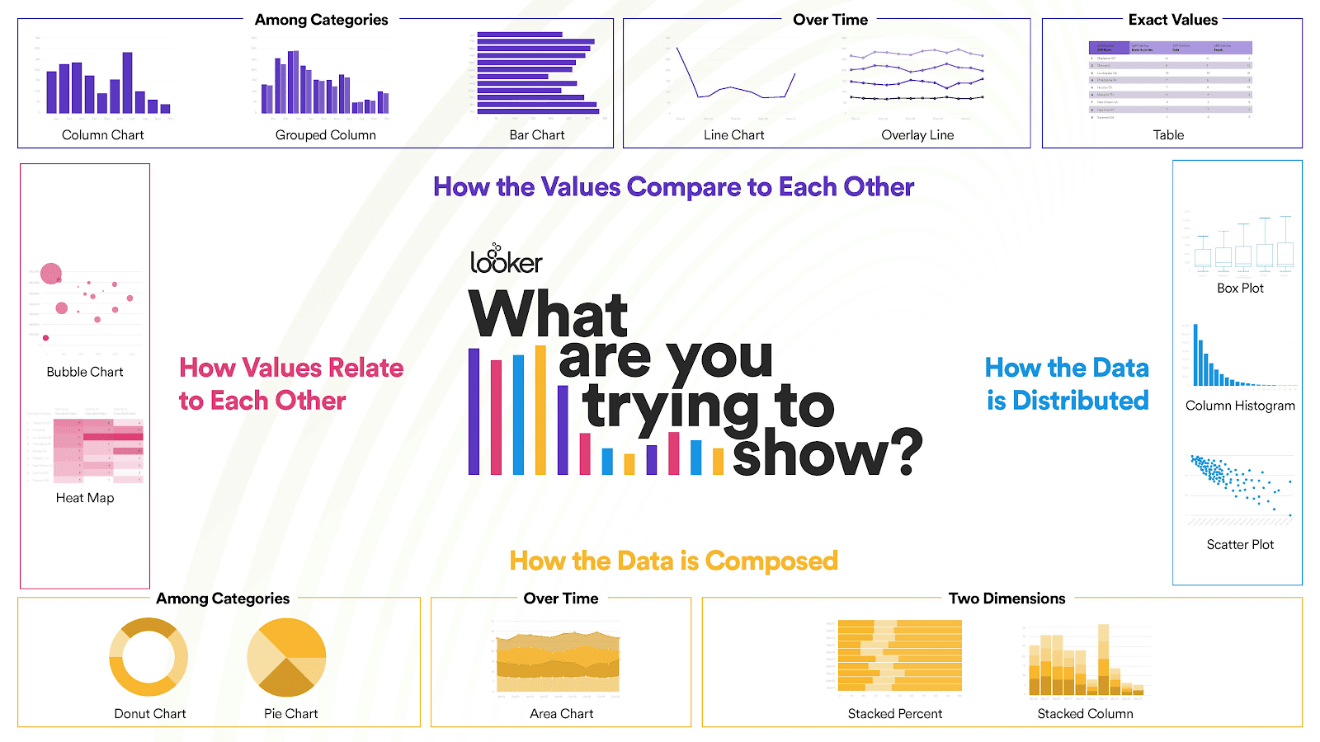
Looker Studio
Looker Studio, formerly known as Google Data Studio, is a cloud-based data visualization tool that you can use to turn data into shareable dashboards and reports. Available to anyone with a Google account, it’s a free tool that can connect to a wide variety of data sources, including databases.

Slide 6
Data Modeling Languages
A data modeling language is a specialized language used to represent and structure data, defining its types, relationships, and constraints. It's a tool for creating semantic models, allowing for abstraction, modularity, and efficiency in data representation. These languages are crucial for data management, ensuring consistency and clarity across different systems and for facilitating communication between stakeholders.
Purpose of Data Modeling Languages:
Abstraction: Data modeling languages provide a way to represent complex data in a simplified, abstract manner, hiding unnecessary details and focusing on essential characteristics.
Modularity: They enable the breakdown of data into manageable modules or components, making it easier to understand, modify, and reuse.
Efficiency: By defining data structures and relationships, these languages help optimize data storage and retrieval processes.
Communication: They serve as a common language for data professionals, business analysts, and other stakeholders to understand and discuss data requirements.
Data Integrity: Data modeling languages help enforce rules and constraints, ensuring data consistency and accuracy.
Database Design: They play a vital role in designing the structure of databases, defining tables, columns, relationships, and constraints.

Slide 7

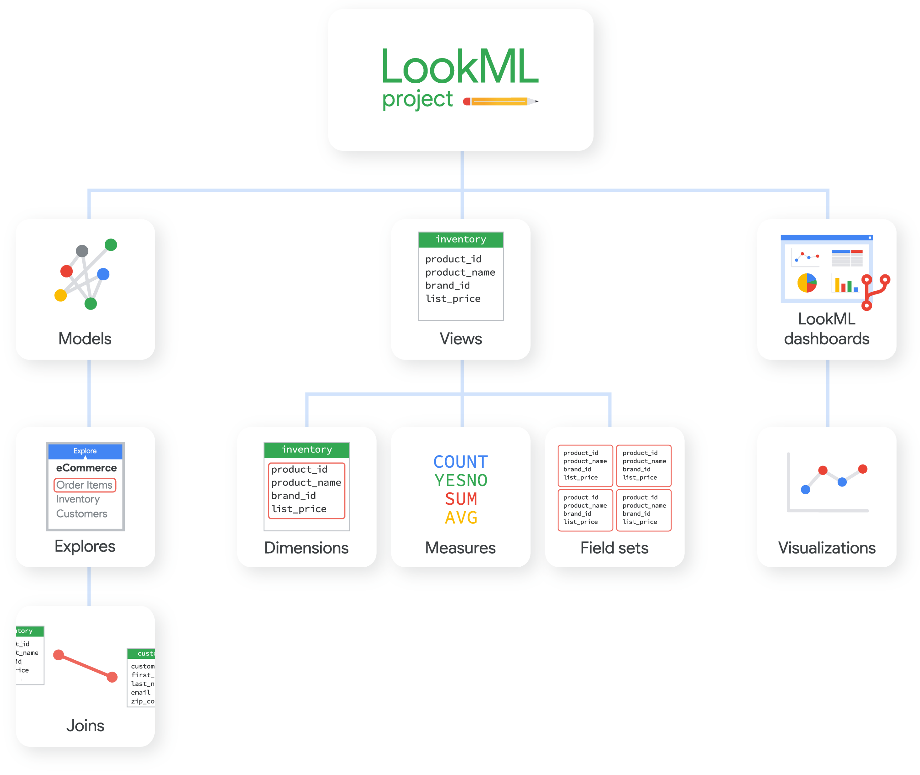
LookML
LookML is a data modeling language used in the Looker development environment to create semantic data models. A semantic data model is an approach to structuring data that emphasizes the meaning and relationships between data elements.
Parts of a LookML Project

Slide 8

Thank You :)

